Slide 1
Fundamentals of
Electric Circuit
2020.5
Chapter 12
Balanced Three-Phase Circuits

Slide 2
A basic three-phase circuit
Three-phase line
Three-phase
voltage
source
Three-phase
load

Slide 3
Chapter 12
Balanced Three-Phase Circuits
12.1 Basic concepts of three-phase circuit
12.2 Analysis of the Wye-Wye (Y-Y) Circuit
12.3 Analysis of the Wye-Delta (Y-△) Circuit
12.4 Balance Delta-Delta (△-△) Connection
12.5 Balance Delta-Wye (△-Y) Connection
12.6 Summary of Balance Connection
12.7 Power in Balance System
12.8 UnBalance three-phase System

Slide 4
Chapter Contents
1. Basic concepts of three-phase circuit
2. Analysis of the Wye-Wye (Y-Y) circuit
3. Analysis of the Wye-Delta (Y-△) circuit
Chapter Objective
Learning the distinction between single-phase and polyphase systems
Becoming familiar with working with both Y- and △-connected three-phase sources
Becoming familiar with working with both Y- and △-connected networks
Mastering the technique of per-phase analysis of three-phase systems

Slide 5
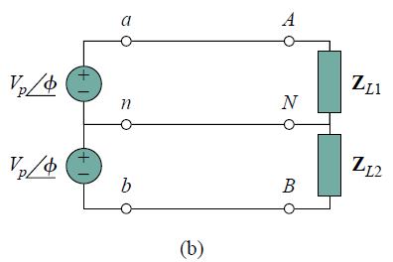
INTRODUCTION
So far in this text, we have dealt with single-phase circuits. A single phase ac power system consists of a generator connected through a pair of wires (a transmission line) to a load. Figure 12.1(a) depicts a single phase two-wire system, where V_{p} is the magnitude of the source voltage and φ is the phase.
What is more common in practice is a single-phase three-wire system, shown in Fig. 12.1(b). It contains two identical sources (equal magnitude and the same phase) which are connected to two loads by two outer wires and the neutral.

Slide 6
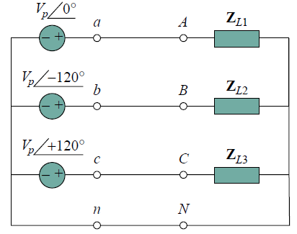
INTRODUCTION
Circuits or systems in which the ac sources operate at the same frequency but different phases are known as polyphase. Figure 12.2 shows a two-phase three-wire system, and Fig. 12.3 shows a three-phase four wire system.
As distinct from a single-phase system, a two-phase system is produced by a generator consisting of two coils placed perpendicular to each other so that the voltage generated by one lags the other by 90◦.
By the same token, a three-phase system is produced by a generator consisting of three sources having the same amplitude and frequency but out of phase with each other by 120◦.

Slide 7
INTRODUCTION
Three-phase systems are important for at least three reasons.
First, nearly all electric power is generated and distributed in three-phase, at the operating frequency of 60 Hz (or ω = 377 rad/s) in the United States or 50 Hz (or ω = 314 rad/s) in some other parts of the world.
When one phase or two-phase inputs are required, they are taken from the three phase system rather than generated independently.
Even when more than three phases are needed—such as in the aluminum industry, where 48 phases are required for melting purposes—they can be provided by manipulating the three phases supplied.

Slide 8
INTRODUCTION
Second, the instantaneous power in a three-phase system can be constant (not pulsating), as we will see in Section 12.7. This results in uniform power transmission and less vibration of three-phase machines.
Third, for the same amount of power, the three-phase system is more economical than the single-phase. The amount of wire required for a three-phase system is for less than that required an equivalent single-phase system.

Slide 9
12.1 Basic concepts of three-phase circuit
1. Balanced three-phase voltages
c-phase voltage
a-phase voltage
Have equal amplitudes and frequencies
Each of the three voltages is 120° out of phase with each of the other two.
120°
b-phase voltage
120°
Choose a-phase as the reference phase.
Phase sequence
abc (or positive) phase sequence: the b-phase voltage lags the a-phase voltage by 120º, and the c-phase voltage lags the b-phase voltage by 120º.
acb (or negative) phase sequence : the b-phase voltage leads the a-phase voltage by 120º, and the c-phase voltage leads the b-phase voltage by 120º.

Slide 10


Some terms
three-phase circuits
balanced three-phase circuits
120°
three-phase source
three-phase load
120°
The phase sequence is the time order in which the voltages pass through their respective maximum values
abc (or positive) phase sequence
the b-phase voltage lags the a-phase voltage by 120º, and the c-phase voltage lags the b-phase voltage by 120º
120°
acb (or negative) phase sequence
120°
the b-phase voltage leads the a-phase voltage by 120º, and the c-phase voltage leads the b-phase voltage by 120º

Slide 11

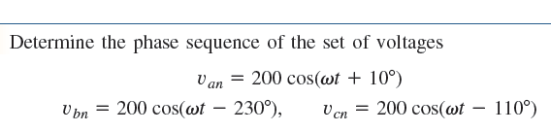



Slide 12




Slide 13


2. Three-phase voltage sources
Two basic connection of an ideal three-phase source
Line terminal
a
a
+
+
Neutral terminal
-
-
-
-
-
+
+
+
-
+
b
b
c
c
Y-connected source
△-connected source

Slide 14



3. Three-phase loads
Two basic connection of three-phase loads
Line terminal
a
a
Neutral terminal
o
b
b
c
c
Y-connected loads
△-connected loads

Slide 15
4. Three-phase circuit
Source Load
Y Y
Y △
△ Y
△ △
Balanced Three-Phase Circuits：balanced three-phase voltages,
balanced three-phase loads

Slide 16














a
-
a
+
+
-
-
-
+
+
b
b
-
+
c
+
c
-
Y-Y connection
Line voltage: the voltage across any pair of lines.
Phasor voltage: voltage across a single phase 。
Line current: the current in a single line .
Phasor current : the current in a single phase 。

Slide 17



+
-
a
+
a
+
-
-
-
-
+
-
+
+
b
-
b
+
+
-
+
c
-
c
Y-△ connection
Phase current
Line current
Phase voltage
Line voltage

Slide 18
a
a
-
+
-
+
-
+
b
b
c
c
△ -Y connection
a
+
a
-
-
+
-
+
b
b
c
c
△ - △ connection

Slide 19


12.2 Analysis of the Wye-Wye (Y-Y) Circuit
A balanced Y-Y system is a three-phase system with a balanced Y-connected source and a balanced Y-connected load.
a
+
a
a
+
-
-
-
N’
N
-
-
-
+
+
+
+
b
b
b
c
c
Y-Y connection (three-phasor three-wire circuit)

Slide 20
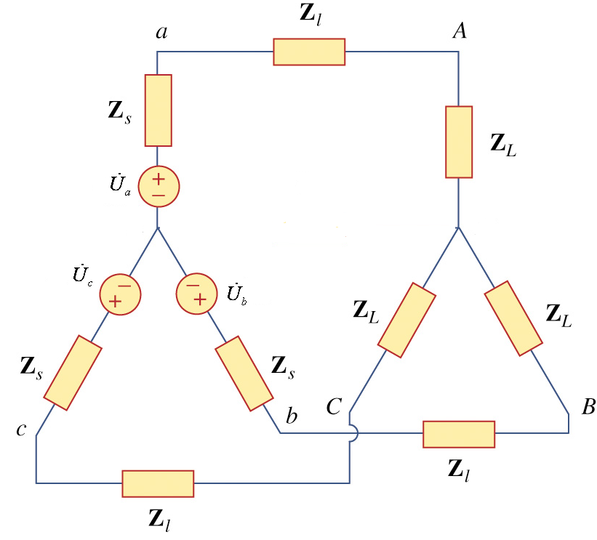

Slide 21
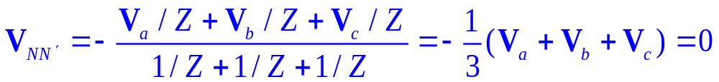
a
+
a
a
+
-
-
-
N’
N
-
-
-
+
+
+
+
b
b
b
c
c
Apply the nodal analysis and select the node N’ as reference node, we have
Thus we can also get the following equivalent circuit

Slide 22

Thus we can get the following equivalent circuit
a
+
a
a
+
-
-
-
N’
N
-
-
-
+
+
+
+
b
b
b
c
c

Slide 23























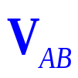


a
+
a
a
+
+
+
-
-
Z₀
-
-
N
N’
-
-
-
-
+
+
-
+
b
+
b
b
+
+
+
c
c
-
Y-Y connection (three-phasor four-wire circuit)
Suppose are known and in the abc sequences, try to calculate
(1) Phasor currents
(2) Line currents
(3) Phasor voltage
(4) Line voltage

Slide 24
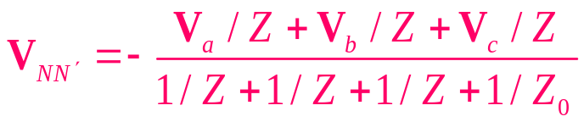
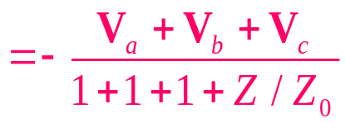

a
+
a
a
+
+
+
-
-
Z₀
-
-
N
N’
-
-
-
-
+
+
-
+
b
+
b
b
+
+
+
c
c
-
Apply the nodal analysis, we have
Since
Thus we can get the following equivalent circuit

Slide 25






Thus we can get the following equivalent circuit
a
+
a
a
+
+
+
-
-
Z₀
-
-
N
N’
-
-
-
-
+
+
-
+
b
+
b
b
+
+
+
c
c
-
A three-phase circuit changes into three single phase circuits now.
It is easy to find phase currents and phase voltage.

Slide 26
a
+
+
-
-
N
N’
N
-
N’
-
+
+
b
-
N
N’
-
-
+
+
+
c
c

Slide 27




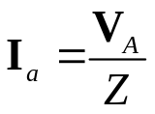
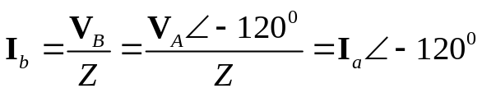
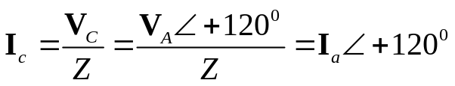
a
+
a
a
+
+
+
-
-
-
-
N
N’
-
-
-
-
+
+
-
+
b
+
b
b
+
+
+
c
c
-
phase voltages：
To get phasor voltage and phasor currents: just calculate one phase voltage and phase current, then we can write other phasor voltages and phasor currents directly.
phase currents：

Slide 28



a
+
a
a
+
+
+
-
-
-
-
N
N’
-
-
-
-
+
+
-
+
b
+
b
b
+
+
+
c
c
-
line currents：
  To get line currents: just calculate one phase current, then we can write all of the line currents directly.

Slide 29













line voltages：
a
+
a
a
+
+
+
-
-
-
-
N
N’
-
-
-
-
+
+
-
+
b
+
b
b
+
+
+
c
c
-
120°
So
We can also obtain the following result in the similar way
120°

Slide 30
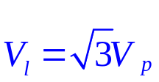




Conclusion:
In the Y-Y circuit, I_{l}= I_{p.}
a
+
+
-
In the balanced Y-Y circuit,
-
-
N’
-
-
+
b
+
+
+
c
-
Steps for analysis the balanced Y-Y circuit
Draw the single-phase equivalent circuit (usually a-phase circuit)
Calculate its phase voltage and phase current.
Write other phase voltages and phase currents.
Write line current and line voltage.

Slide 31
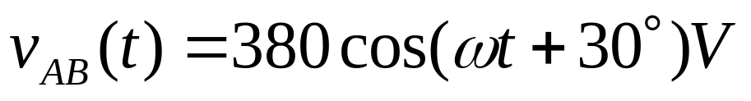
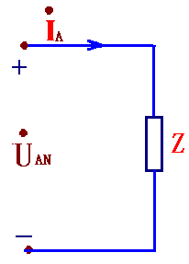

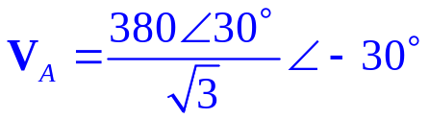

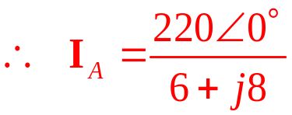



Example 1. In one balanced three-phase Y-Y circuits, Z=6+j8Ω,
Calculate the currents.
Solution:
Since
Draw the a-phase circuit
How to get the voltage?

Slide 32
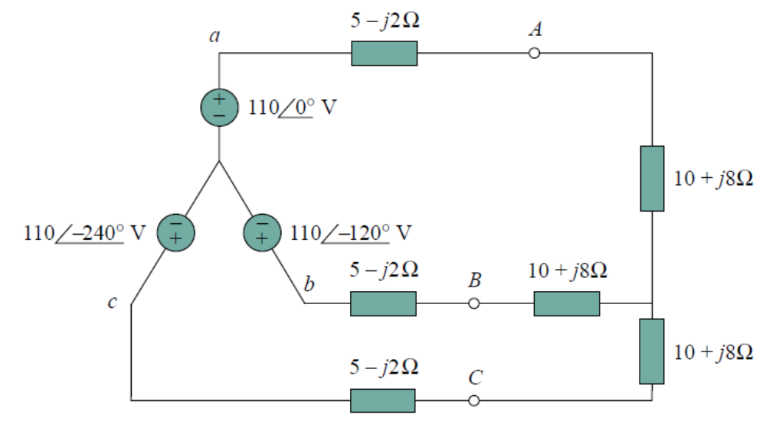
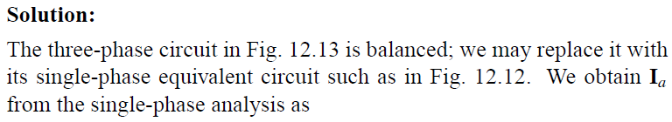
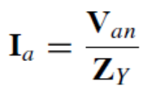
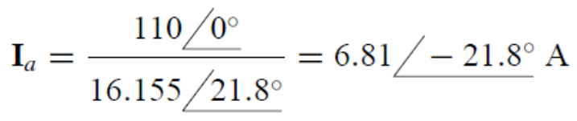

EXAMPLE 9.2
Calculate the line currents in the three-wire Y-Y system of Fig. 12.13.

Slide 33

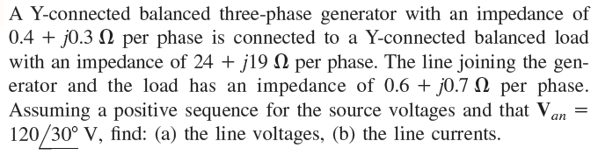
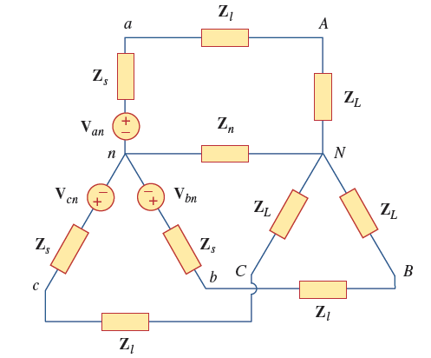


Slide 34













12.3 Analysis of the Wye-Delta (Y-△) Circuit
The balanced Y-Δ system consists of a balanced Y-connected source feeding a balanced Δ-connected load. The balanced Y-Δ system is shown following the figure.
A
+
-
a
+
a
+
-
-
-
-
+
-
+
b
-
b
C
+
+
B
+
-
+
c
-
c
Assuming the positive phase sequence , the source voltages are again
The line voltages and phase voltages are

Slide 35

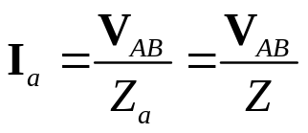
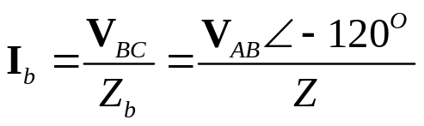
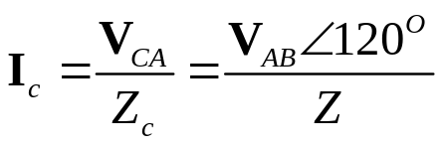
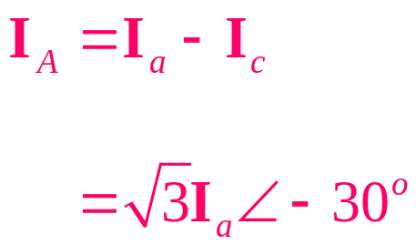
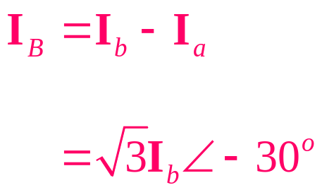
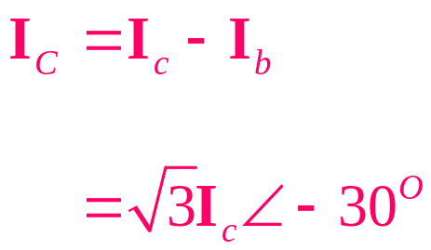
A
+
-
a
+
a
+
-
-
-
-
+
-
+
b
-
b
C
+
+
B
+
-
+
c
-
c
showing that the line voltages are equal to the voltages across the load impedances for this system configuration.
From these voltages, we can obtain th phase currents as
These currents have the same magnitude but are out of phase with each other by 120^{o.}
The line currents are obtained from the phase currents by applying KCL at nodes A,B, and C. Thus

Slide 36
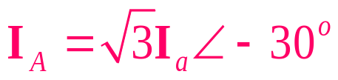
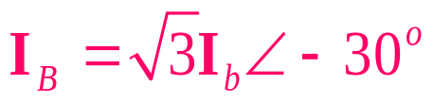
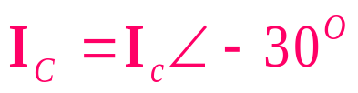
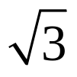
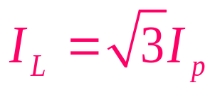
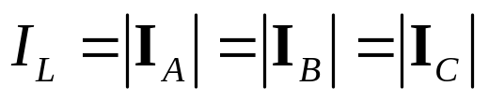
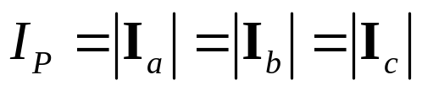
Showing that the magnitude of I_{L} of the line current is
times the magnitude I_{p} of the phase current, or
where
Also, the line currents lag the corresponding phase currents by 30º

Slide 37
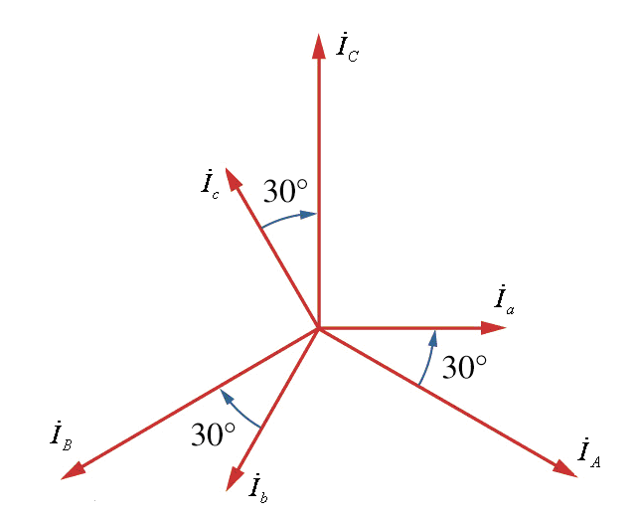
Phasor diagram illustrating the relationship between phase and line currents.

Slide 38


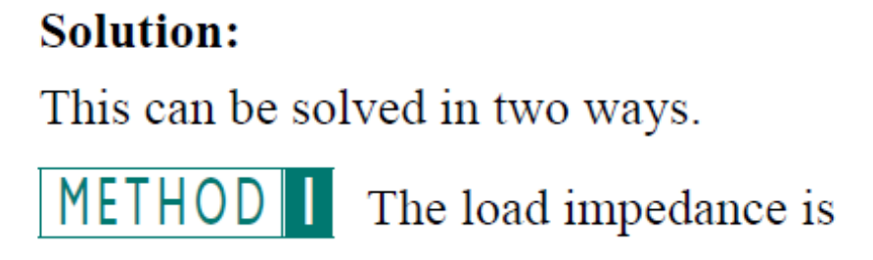





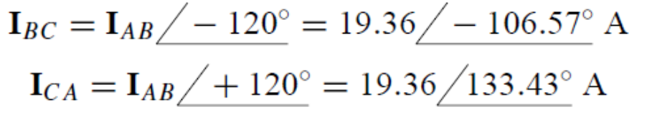
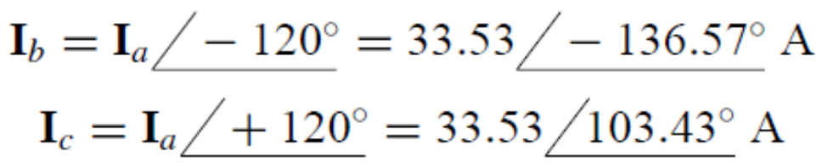
EXAMPLE 12.3
A balanced abc-sequence Y-connected source with
is connected to Δ-connected balanced load
per phase.
Calculate the phase and line currents.

Slide 39
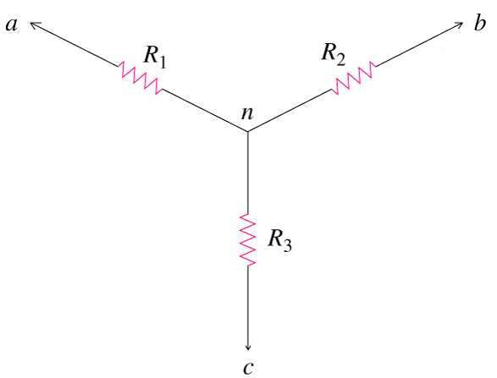
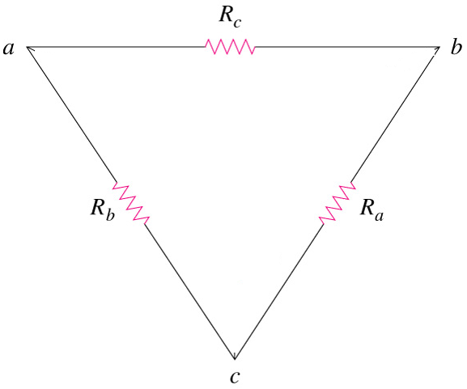
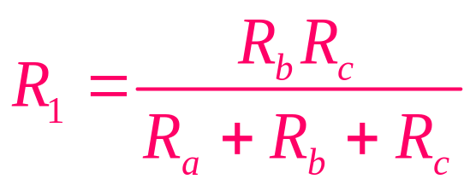
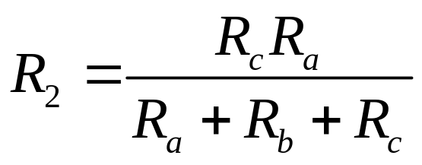
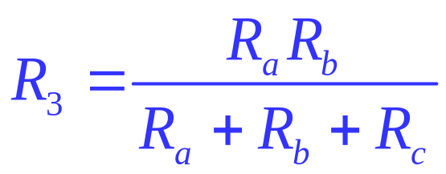
Delta -> Wye

Slide 40
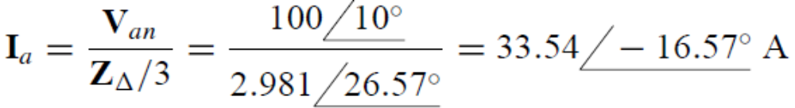
EXAMPLE 12.3
A balanced abc-sequence Y-connected source with
is connected to Δ-connected balanced load
per phase.
Calculate the phase and line currents.

Slide 41
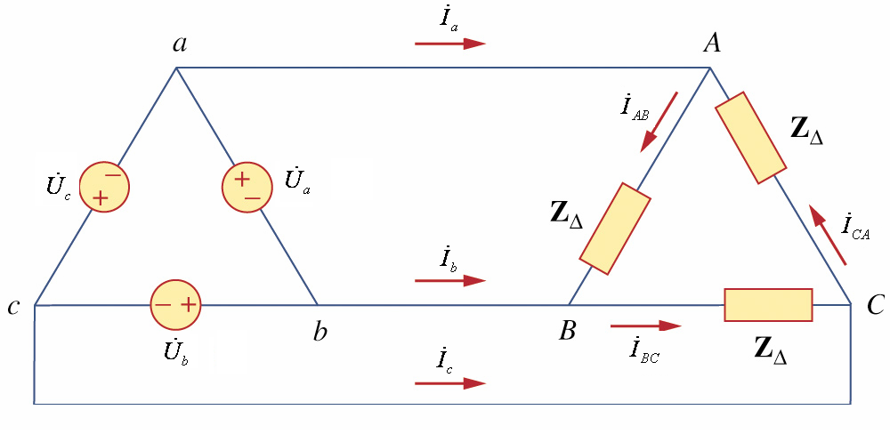

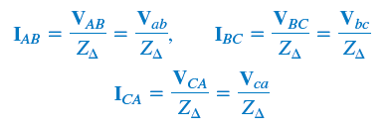




12.4 Balance Delta-delta Connection
A balanced Δ- Δsystem is one in which both the balanced source and balanced load are Δ-connected
A balanced Δ- Δ connection

Slide 42

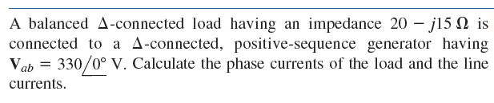
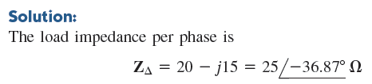






Slide 43

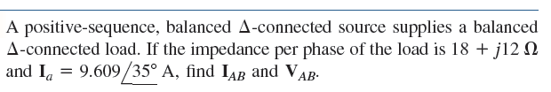


Slide 44

12.5 Balance Delta-Wye Connection
A balanced Δ- Y system consists of a balanced Δ-connected source feeding a balanced Y-connected load.
A balanced Δ- Y connection

Slide 45








( choose as a reference phasor )

Slide 46









Slide 47


12.6 Summary of Balance Connection

Slide 48



Slide 49








12.7 Power in Balance System
Let us now consider the power in a balanced three-phase system. Examine the instantaneous power absorbed by the load.
For a Y-connected load, the phase voltages are
If , the phase currents lag behind their corresponding phase voltages by θ. Thus
Where is the effective value of the phase current.

Slide 50



The total instantaneous power in the load is the sum of the instantaneous powers in the three phases; that is,
Applying the trigonometric identity
gives

Slide 51








1、average power
Balanced three phase system：
2、reactive power
Balanced three phase system：

Slide 52




3、apparent power
Balanced three phase system：
4、complex power

Slide 53
12.8 UnBalance three-phase System
An unbalanced system is due to unbalanced voltage sources or an unbalanced load. Generally, the source voltage is balanced, but the load is unbalanced.
Unbalanced three-phase system are solved by direct application of mesh and nodal analysis.

Slide 54








Example 12.4
In the circuit shown in the figure . . Find line currents.
Solution
V_{p}=220V
3+j2
1）when Z_{N}=0：
4+j4
2+j
Load currents are unbalanced, however, they are independent , and do not impact each other.

Slide 55











2）when Z_{N}=4+j3：
3+j2
4+j4
2+j
Load currents and voltages are unbalanced, and they are dependent and impact each other.

Slide 56









3）when Z_{N}=∞：
3+j2
4+j4
2+j

Slide 57












Phasor diagram
+j
↑
→
+1
From the phasor diagram, we know that the voltage between the neutral point of the source and the neutral of the load does not equal zero , because of the absence of neutral line, and results in unbalanced phase voltages.
Therefore, in the three-phase four-wire system, the neutral line has large diameter, and it does not connect to the switch and fuse-element

Slide 58



Summary
The phase sequence is the order in which the phase voltages of a three-phase generator occur with respect to time. In an abc sequence of balanced source voltages, leads by 120º,which in turn leads by 120º. In an acb sequence of balanced source voltages, leads by 120º,which in turn leads by 120º.
A balanced wye-or delta-connected load is one in which the three-phase impedances are equal.
The easiest way to analyze a balanced three-phase circuit is to transform both the source and the load to Y-Y system and then analyze the single-phase equivalent circuit.
The line current I_{L}is the current flowing from the generator to the load in each transmission line in a three-phase system. The line voltage V_{L} is the voltage between each pair of lines, excluding the neutral line if it exists. The phase voltage V_{p} is the voltage of each phase.

Slide 59


For a wye-connected load,
For a delta-connected load
The total instantaneous power in a balanced three-phase system is constant and equal to the average power.
The total complex power absorbed by a balanced three-phase Y-connected or Δ-connected load is where θis the angle of the load impedances.
An unbalanced three-phase system can be analyzed using nodal or mesh analysis.
The total real powr is measured in three-phases using either the three-wattmeter method or the two wattmeter method

